Slide 1


RECONSTRUCTION OF HILL STREET EAST
(HERRICK STREET TO GARTSHORE STREET),
FERGUS

Slide 2


Introduction and Purpose
Welcome to the Virtual Open House for the Reconstruction of
Hill Street East, Fergus starting in the spring of 2025. The purpose of this Open House is to:
  Provide an Opportunity to Understand the Project
  Review the Construction Plans
  Learn what you can expect before and during construction
  Provide expected Timelines and Next Steps
  Provide contact information should you have any questions or wish to discuss the project in further detail

Slide 3
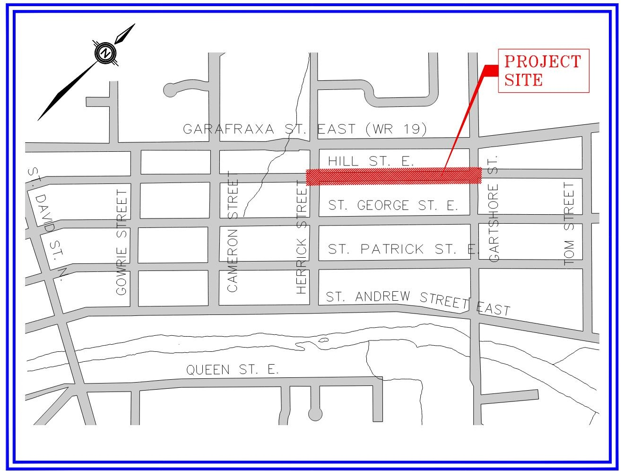
Project Location

Slide 4
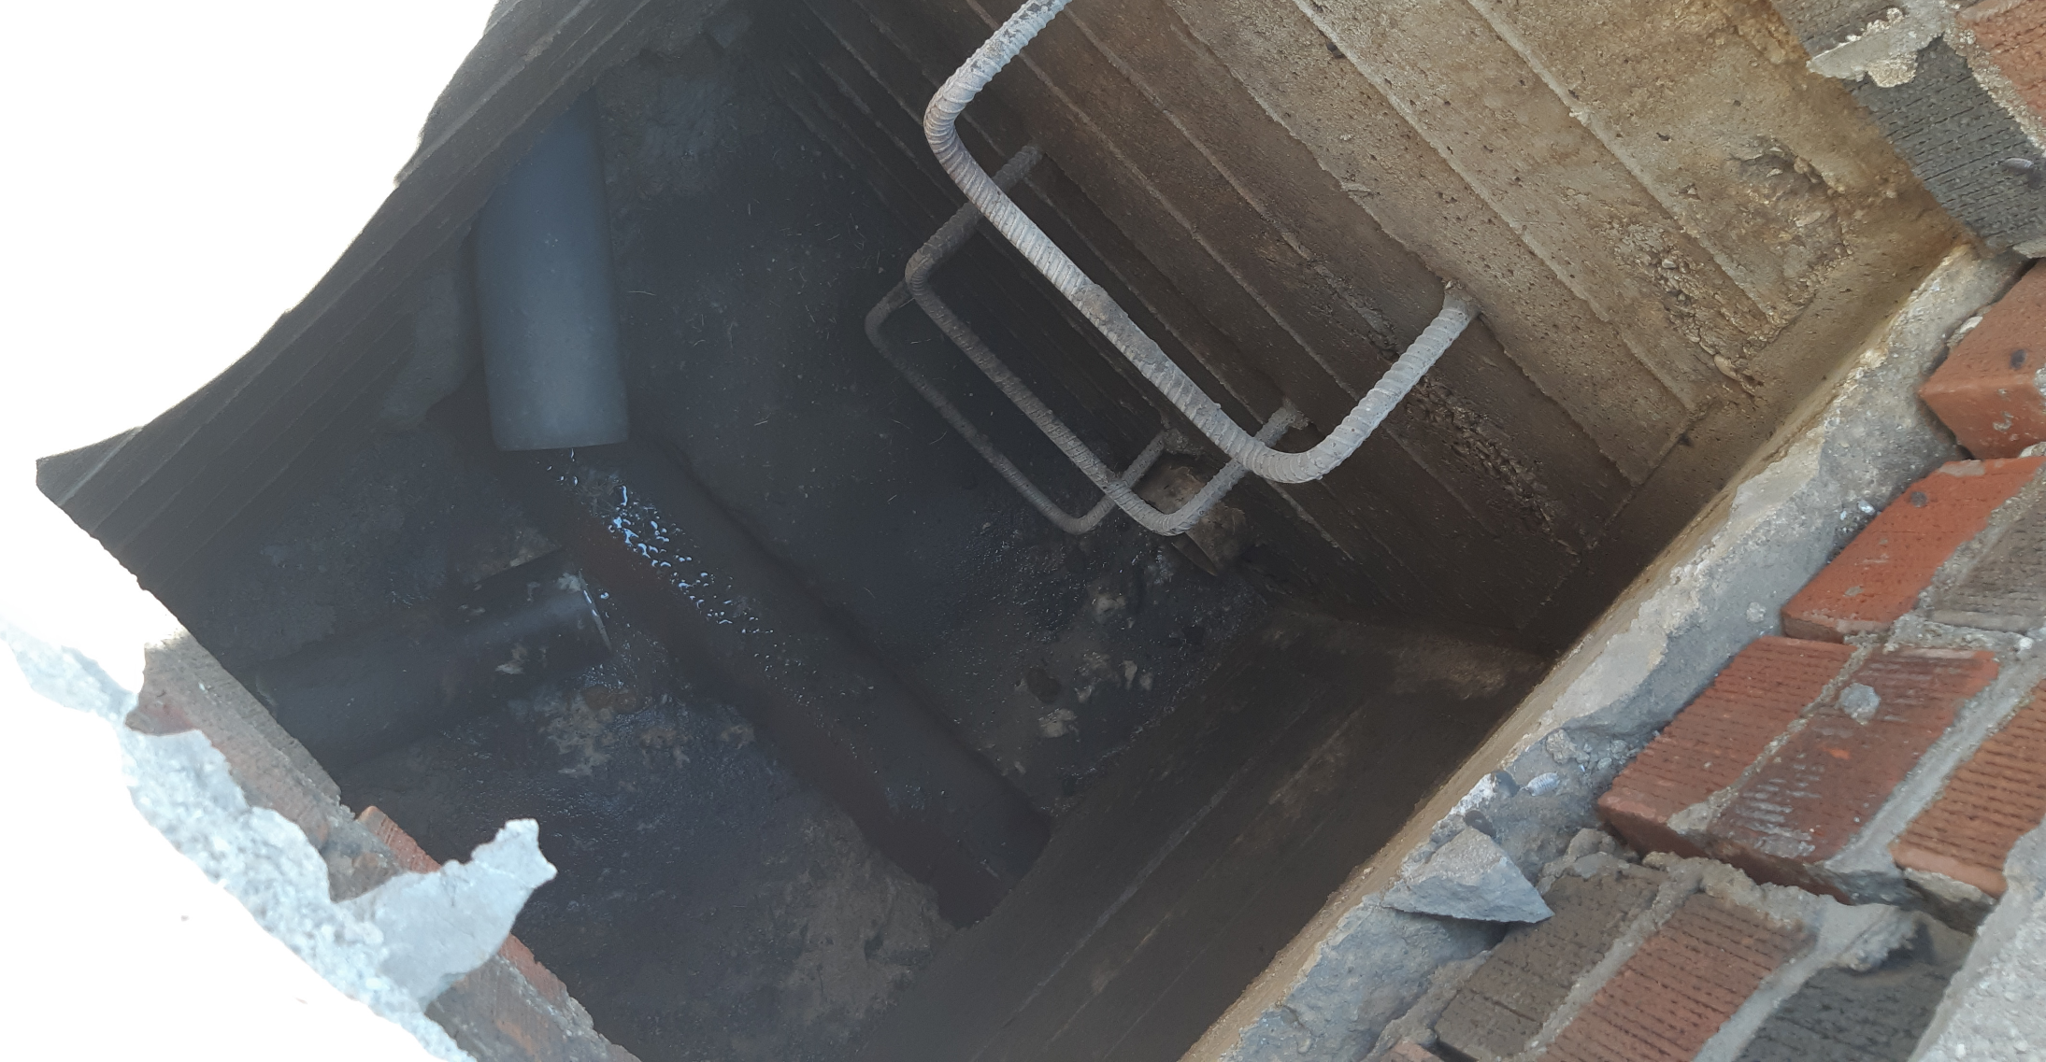
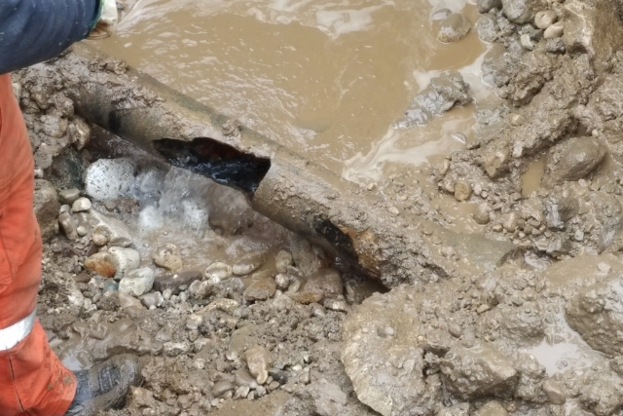
Purpose for Reconstruction
Cast-In-Place Sanitary Maintenance Hole
Watermain break
Underground sanitary and water infrastructure is aging and reaching the end of its service life.

Slide 5
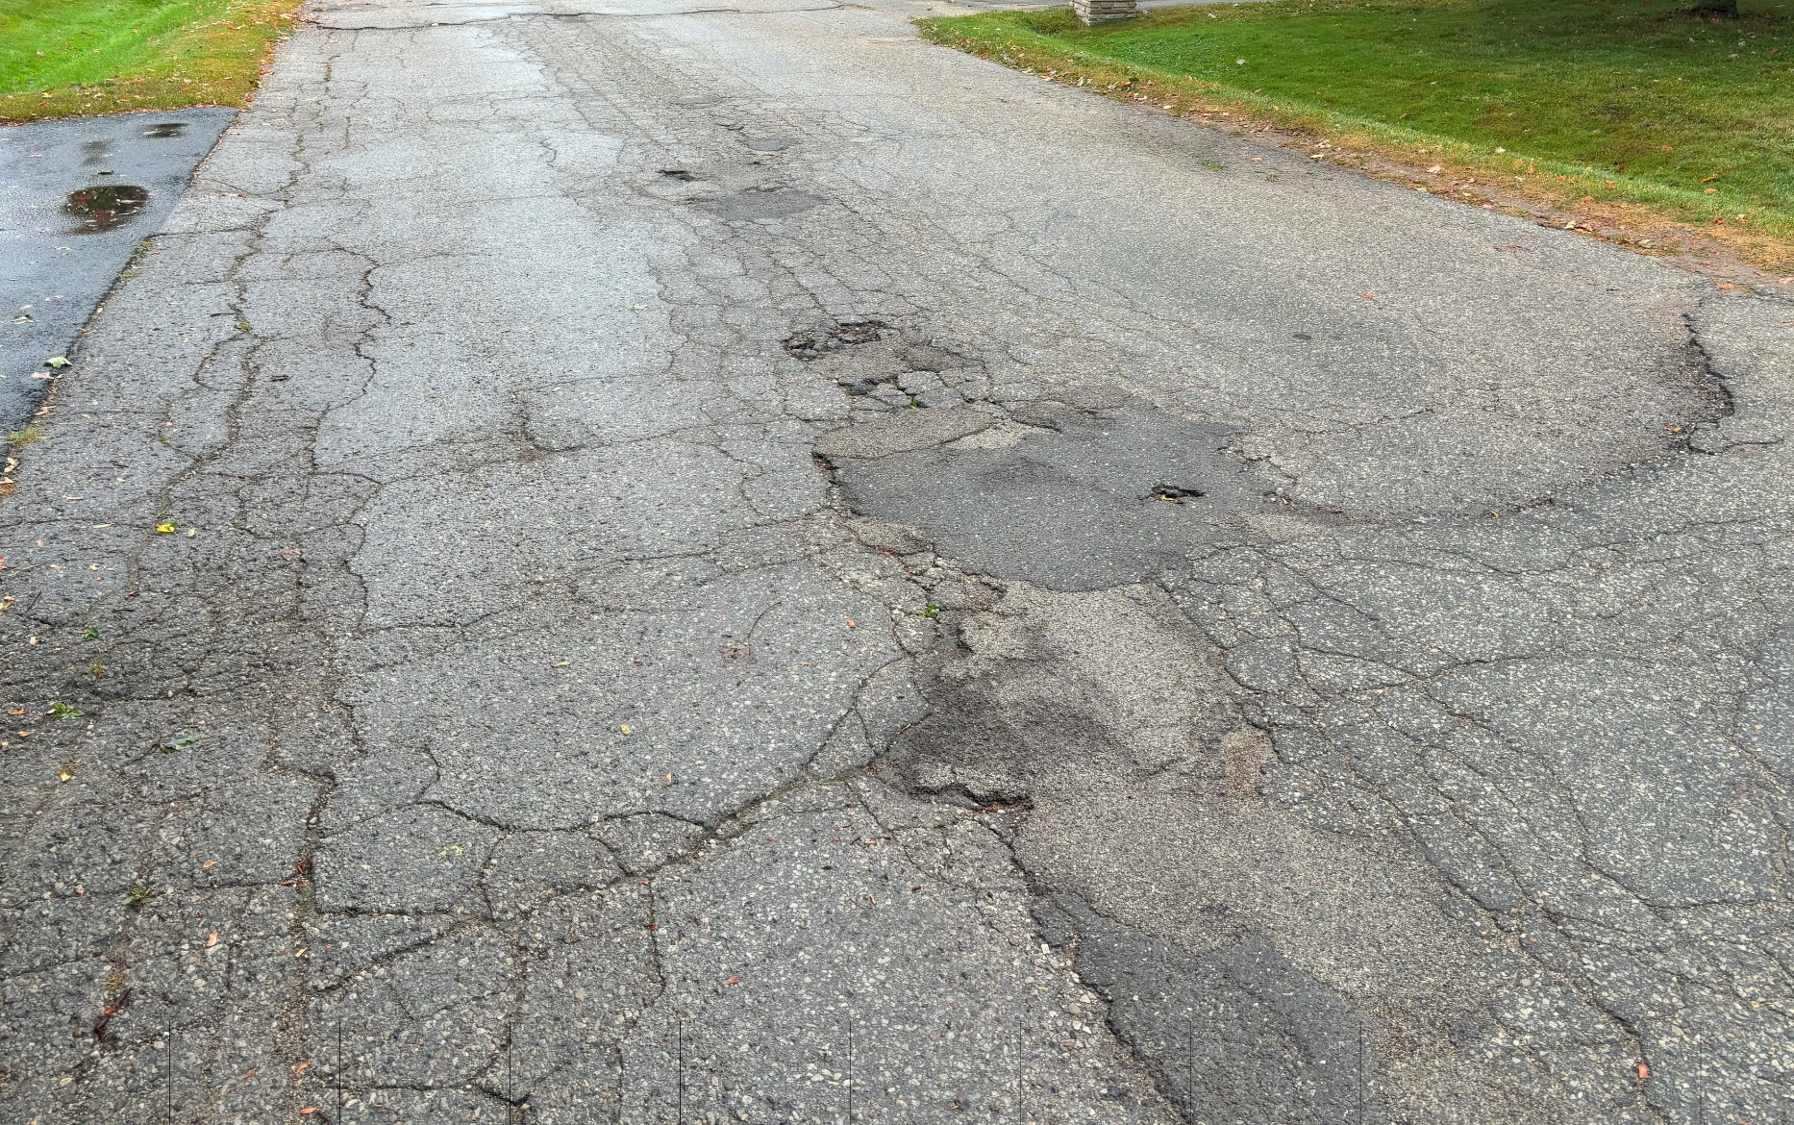
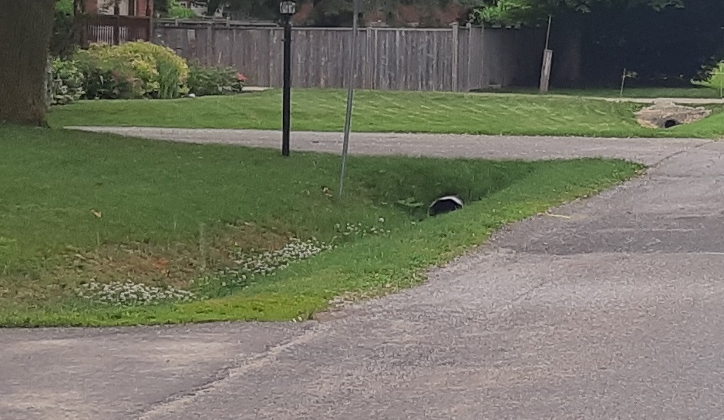
Purpose for Reconstruction
Hill Street East Asphalt Condition
Hill Street East Rural Cross Section
Existing road cross section is rural complete with ditches and driveway culverts. No existing sidewalks for pedestrian traffic.
Existing road base and asphalt surface are deteriorating.

Slide 6
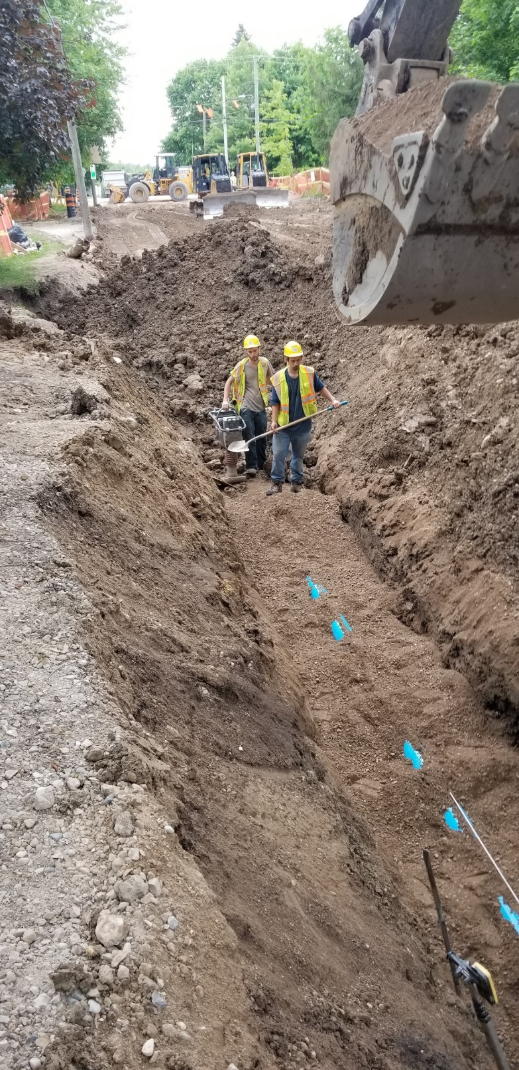
Proposed Work
Reconstruction of Hill Street East will include new road, curb and sidewalk.
Replacement of existing watermain and sanitary sewer on Hill Street East.
Installation of new storm sewer to eliminate ditches and culverts on Hill Street East.
Typical General Contractor’s working hours are Monday to Friday from 7:00AM to 7:00PM, and Saturdays as required (modified hours).

Slide 7
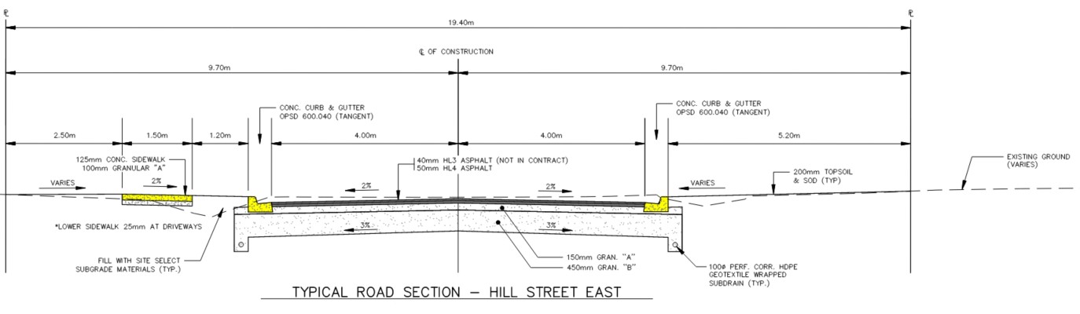
Typical Cross Section
North
South

Slide 8
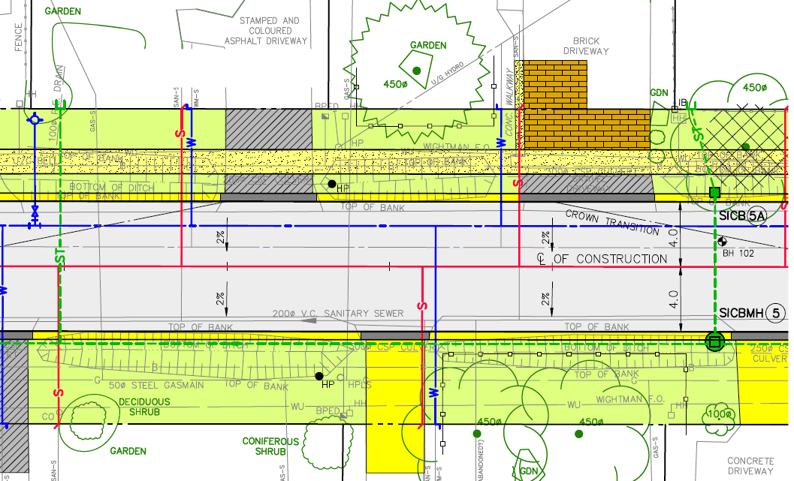
Understanding the Construction Drawings
Fire Hydrant
Reinstated Driveway
Water Service
Tree Removal
Included as an attachment to the Connect CW - Virtual Open House website for the Reconstruction of Hill Street East are the detailed design drawings. The image to the left will assist in determining what the typical features on the drawing represent.
Concrete Sidewalk
Storm Sewer
Watermain
Curb and Gutter
Storm Sewer
Sanitary Service
Sanitary Sewer

Slide 9
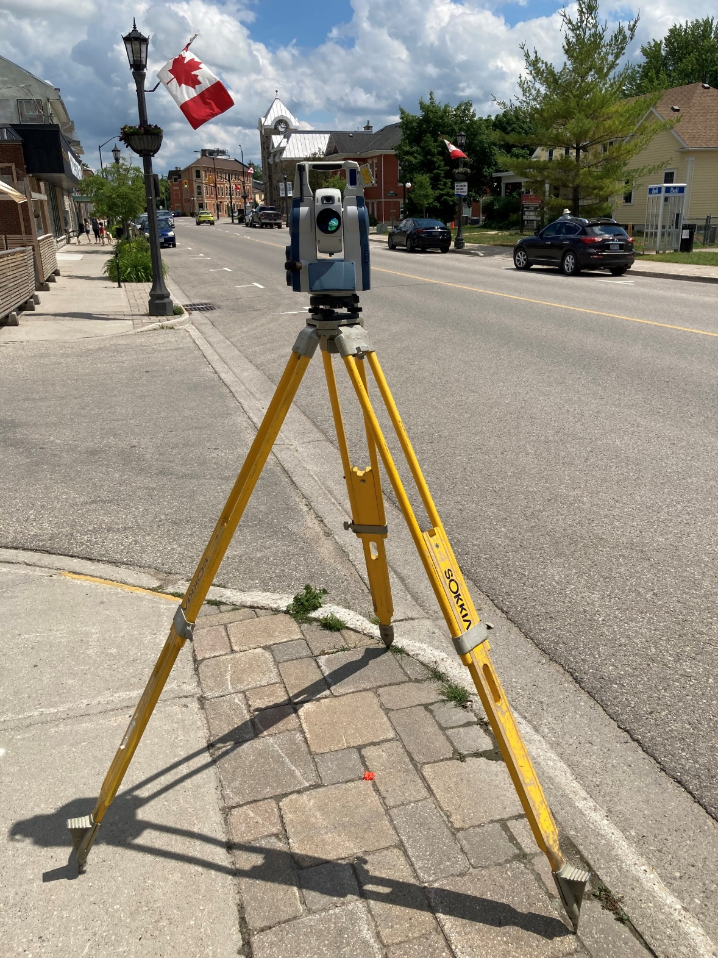
Pre-Engineering
Prior to proceeding with the engineering design, several different site activities have already taken place, including:
  A Topographic Survey to locate edges of pavement, utilities, gardens, trees, fences, elevation changes, etc.
  Drilling within the road for the Geotechnical Investigation has been completed to establish sub-surface soil conditions and excess soil management.
  Ontario Legal Surveyor (OLS) has established the location of the municipal Right-of-Way property lines.
  The Township’s Urban Forestry Manager has completed a Tree Assessment.

Slide 10
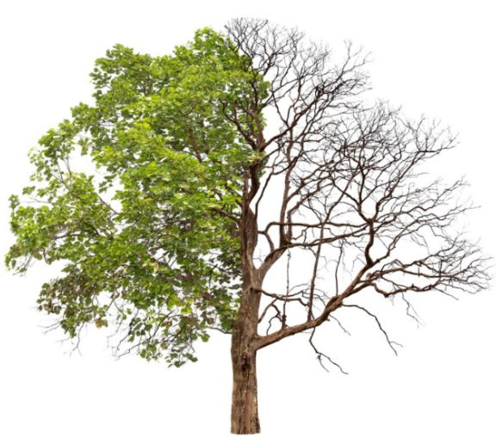
Tree Assessment
A Tree Condition Assessment was conducted by the Township’s Urban Forestry Manager. The reason for this assessment is to identify a trees condition and its ability to withstand disturbance should construction encroach within the root zone of a tree. If it is determined that a tree will not withstand the construction activity, a decision will be made to have it removed prior to the start of construction and later replaced under a tree compensation program developed by the Township.

Slide 11
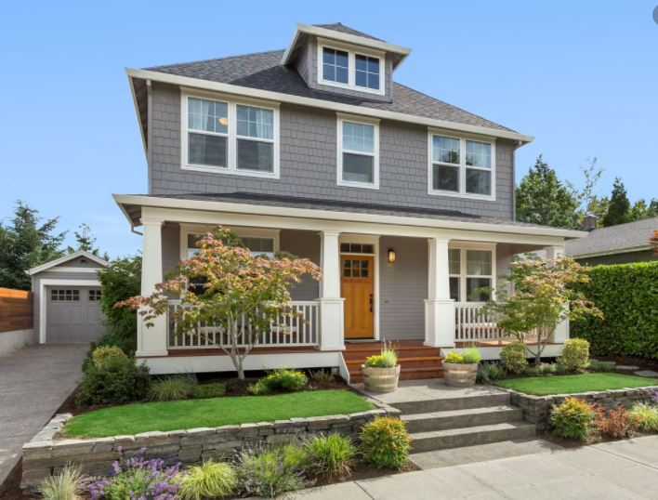
Pre-Condition Survey
Due to the nature of the construction activity, structures and buildings on your property may be inspected to record existing conditions. This will be completed prior to construction. You will be contacted by the general contractor’s subconsultant to set up an individual appointment where necessary.

Slide 12
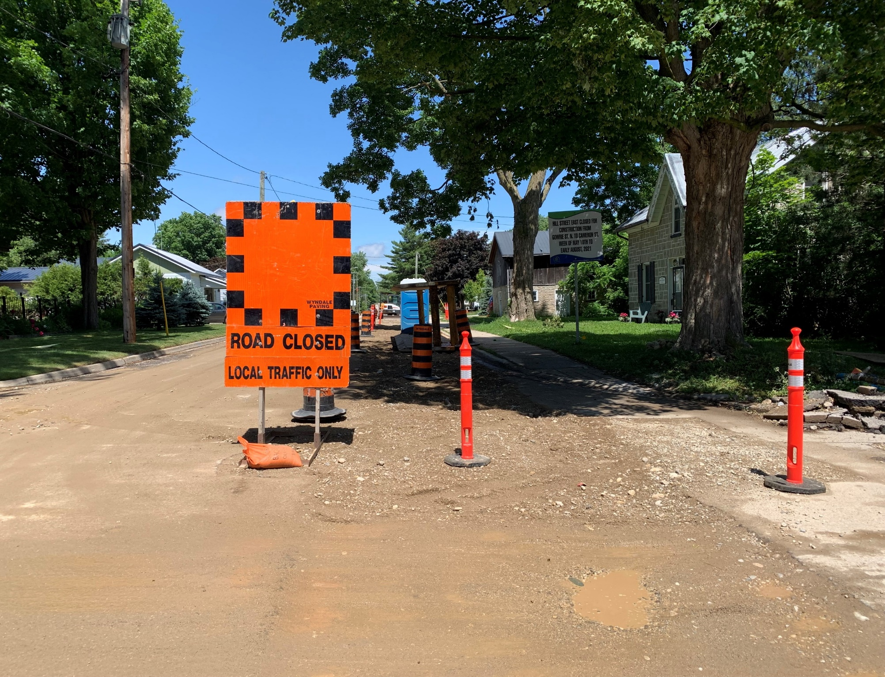
How will Traffic be Managed During Construction?
Hill Street East will be closed to through traffic during construction.
In general, local access to properties will be maintained, however, short duration restrictions may occur from time to time based on construction activities. Access for emergency vehicles will be maintained at all times.
Whenever possible, advance notice will be provided by the contractor in the event access to your property will be temporarily affected.

Slide 13
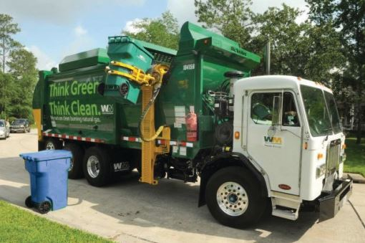
How will Garbage and Recycling Pick-Up be Affected
Garbage and Recycling will be maintained on your regularly scheduled pick-up day.
The contractor will take your bins and garbage from your usual roadside pick-up location and take them to designated to an arranged pick-up location.
Once pick-up has taken place, the contractor will return bins back to your property.
Please ensure your bins have civic addresses on them.

Slide 14
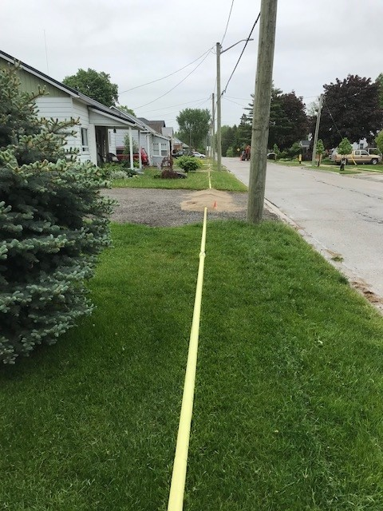
Water Service Interruptions
Water supply will be maintained throughout construction via a temporary watermain that will be typically installed along the frontage of your properties.
Access onto your property may be required to provide the individual temporary water service connection.
Short interruptions can be expected, particularly when individual services are transferred from existing watermain to temporary, and then to the new watermain.
Interruptions will be limited to a few hours and will occur during normal working hours(8:00AM to 4:30PM)
Written notice will be provided when possible in advance of any service interruption.

Slide 15
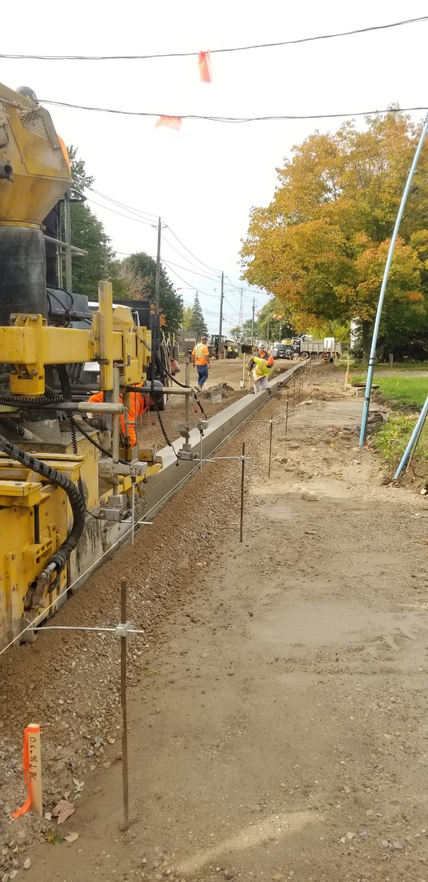
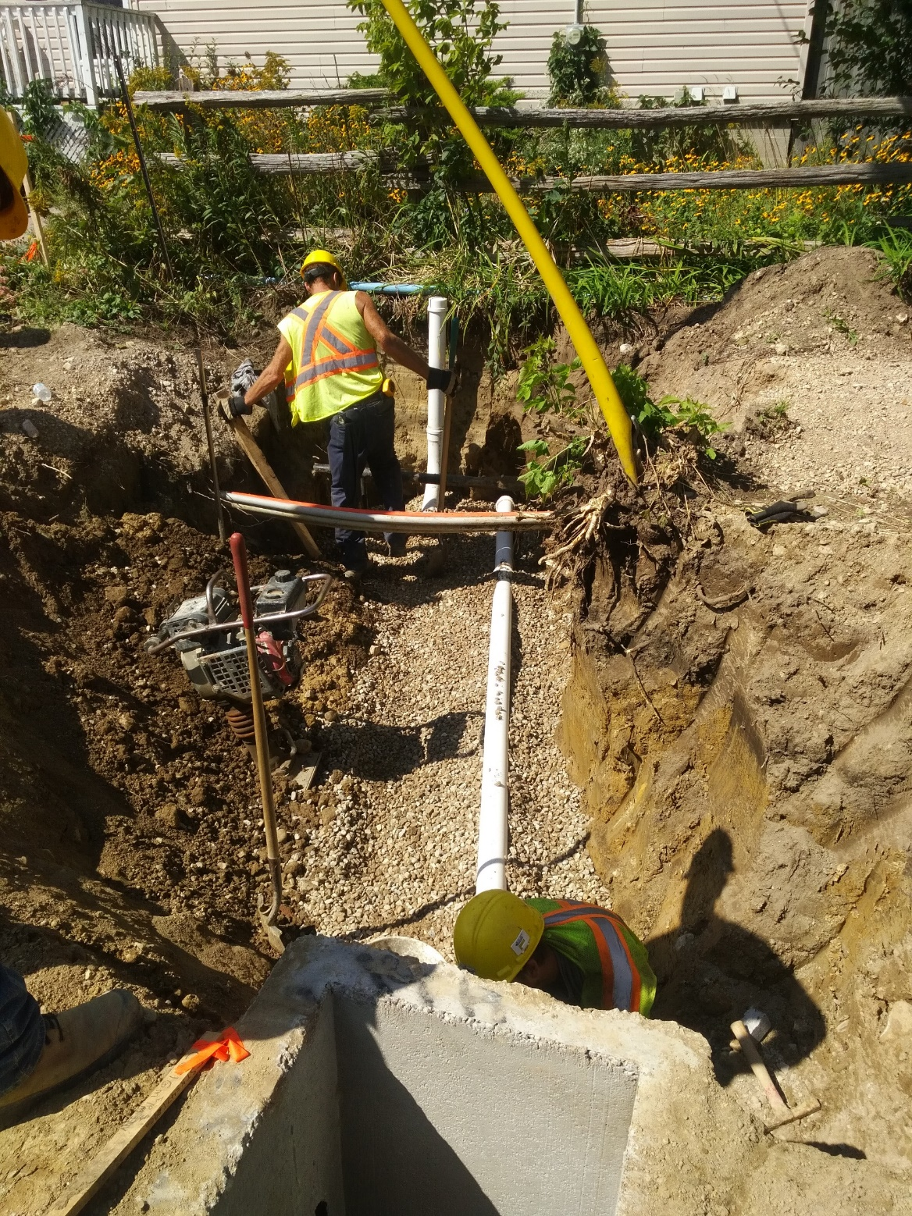
Potential Property Impacts
Impacts to your private landscaping features may occur to tie in the new curb, sidewalk and municipal services.
All landscape works will be restored upon the completion of construction in consultation with the homeowner.
In most cases, it will be necessary to cut back driveways to match the new curb and sidewalk.
Hard surface driveways will be saw-cut and restored with matching material wherever possible.

Slide 16
Project Timing and Next Steps
Winter 2024/2025 - Issue for Contractor Tendering
Spring 2025 - Tender Award and proceed to construction
Fall/Winter 2025 - Construction Completion

Slide 17
Contact Us
Thank you for your participation.
Please submit any questions or comments directly online, email or by phone to the contacts listed below:
Adam Dickieson, C.E.T.
Township of Centre Wellington
519-846-9691 ext. 355
adickieson@centrewellington.ca
David Donaldson, P.Eng.
Triton Engineering Services Limited
519-843-3920 ext. 232
ddonaldson@tritoneng.on.ca

